Slide 1
Lizza - AI-Powered online Voice Assistant
Hackathon Project
Team Members: Ankit, anshu, Akash, hargun singh

Slide 2
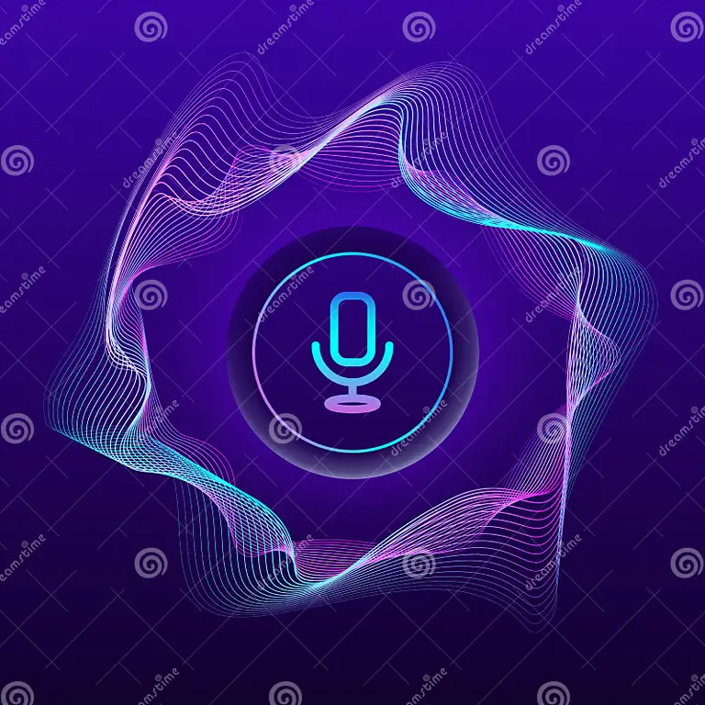
Introduction
- Lizza is an AI-powered voice assistant designed to execute commands efficiently.
- Works online and is fully voice-controlled.
- Activated by the keyword 'Lizza', making it highly personalized.

Slide 3
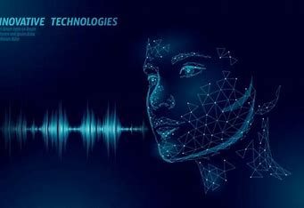
Problem Statement
- Most voice assistants require internet access, limiting accessibility.
- Users need a hands-free, efficient way to perform tasks.
- Privacy concerns with cloud-based voice assistants.

Slide 4
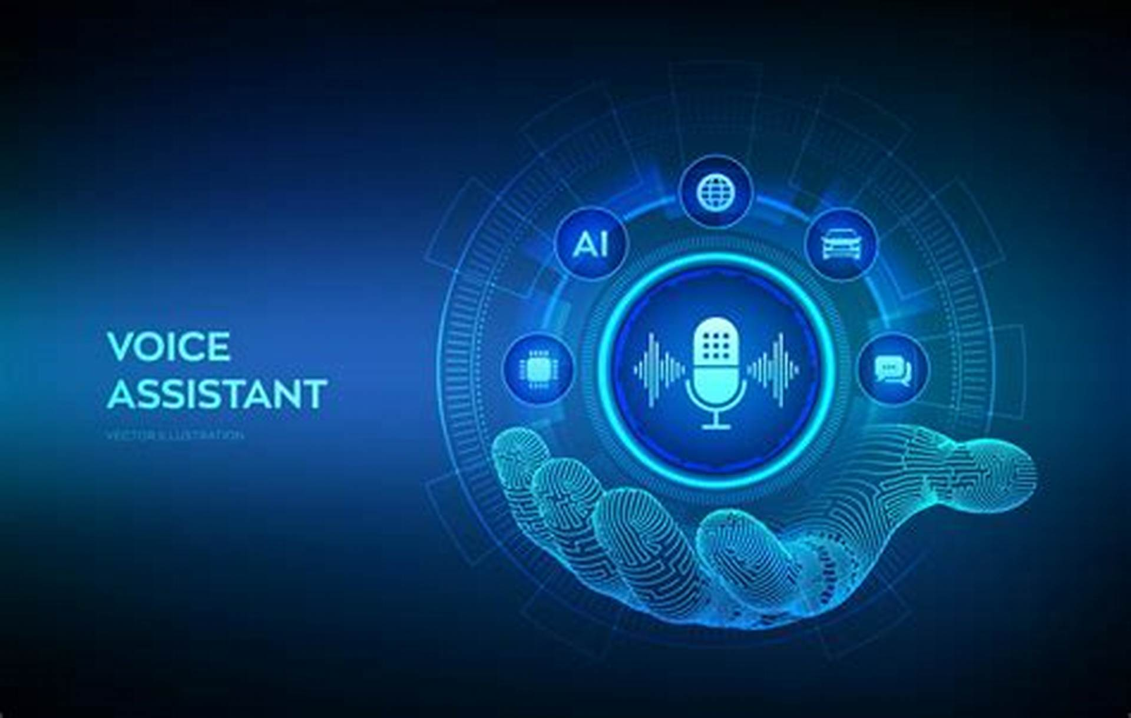
Objectives
- Create a lightweight, online voice assistant.
- Ensure high accuracy in speech recognition.
- Implement multi-functionality (messaging, calling, app control, etc.).
- Provide fast execution with minimal resource consumption.

Slide 5

Features
- online functionality (no internet required).
- Custom wake word: 'Lizza'.
- Task execution:
• Send WhatsApp messages
• Pause/play videos or music
• Make calls
• Close applications.
- Fully voice-controlled.
- Secure and privacy-focused.

Slide 6
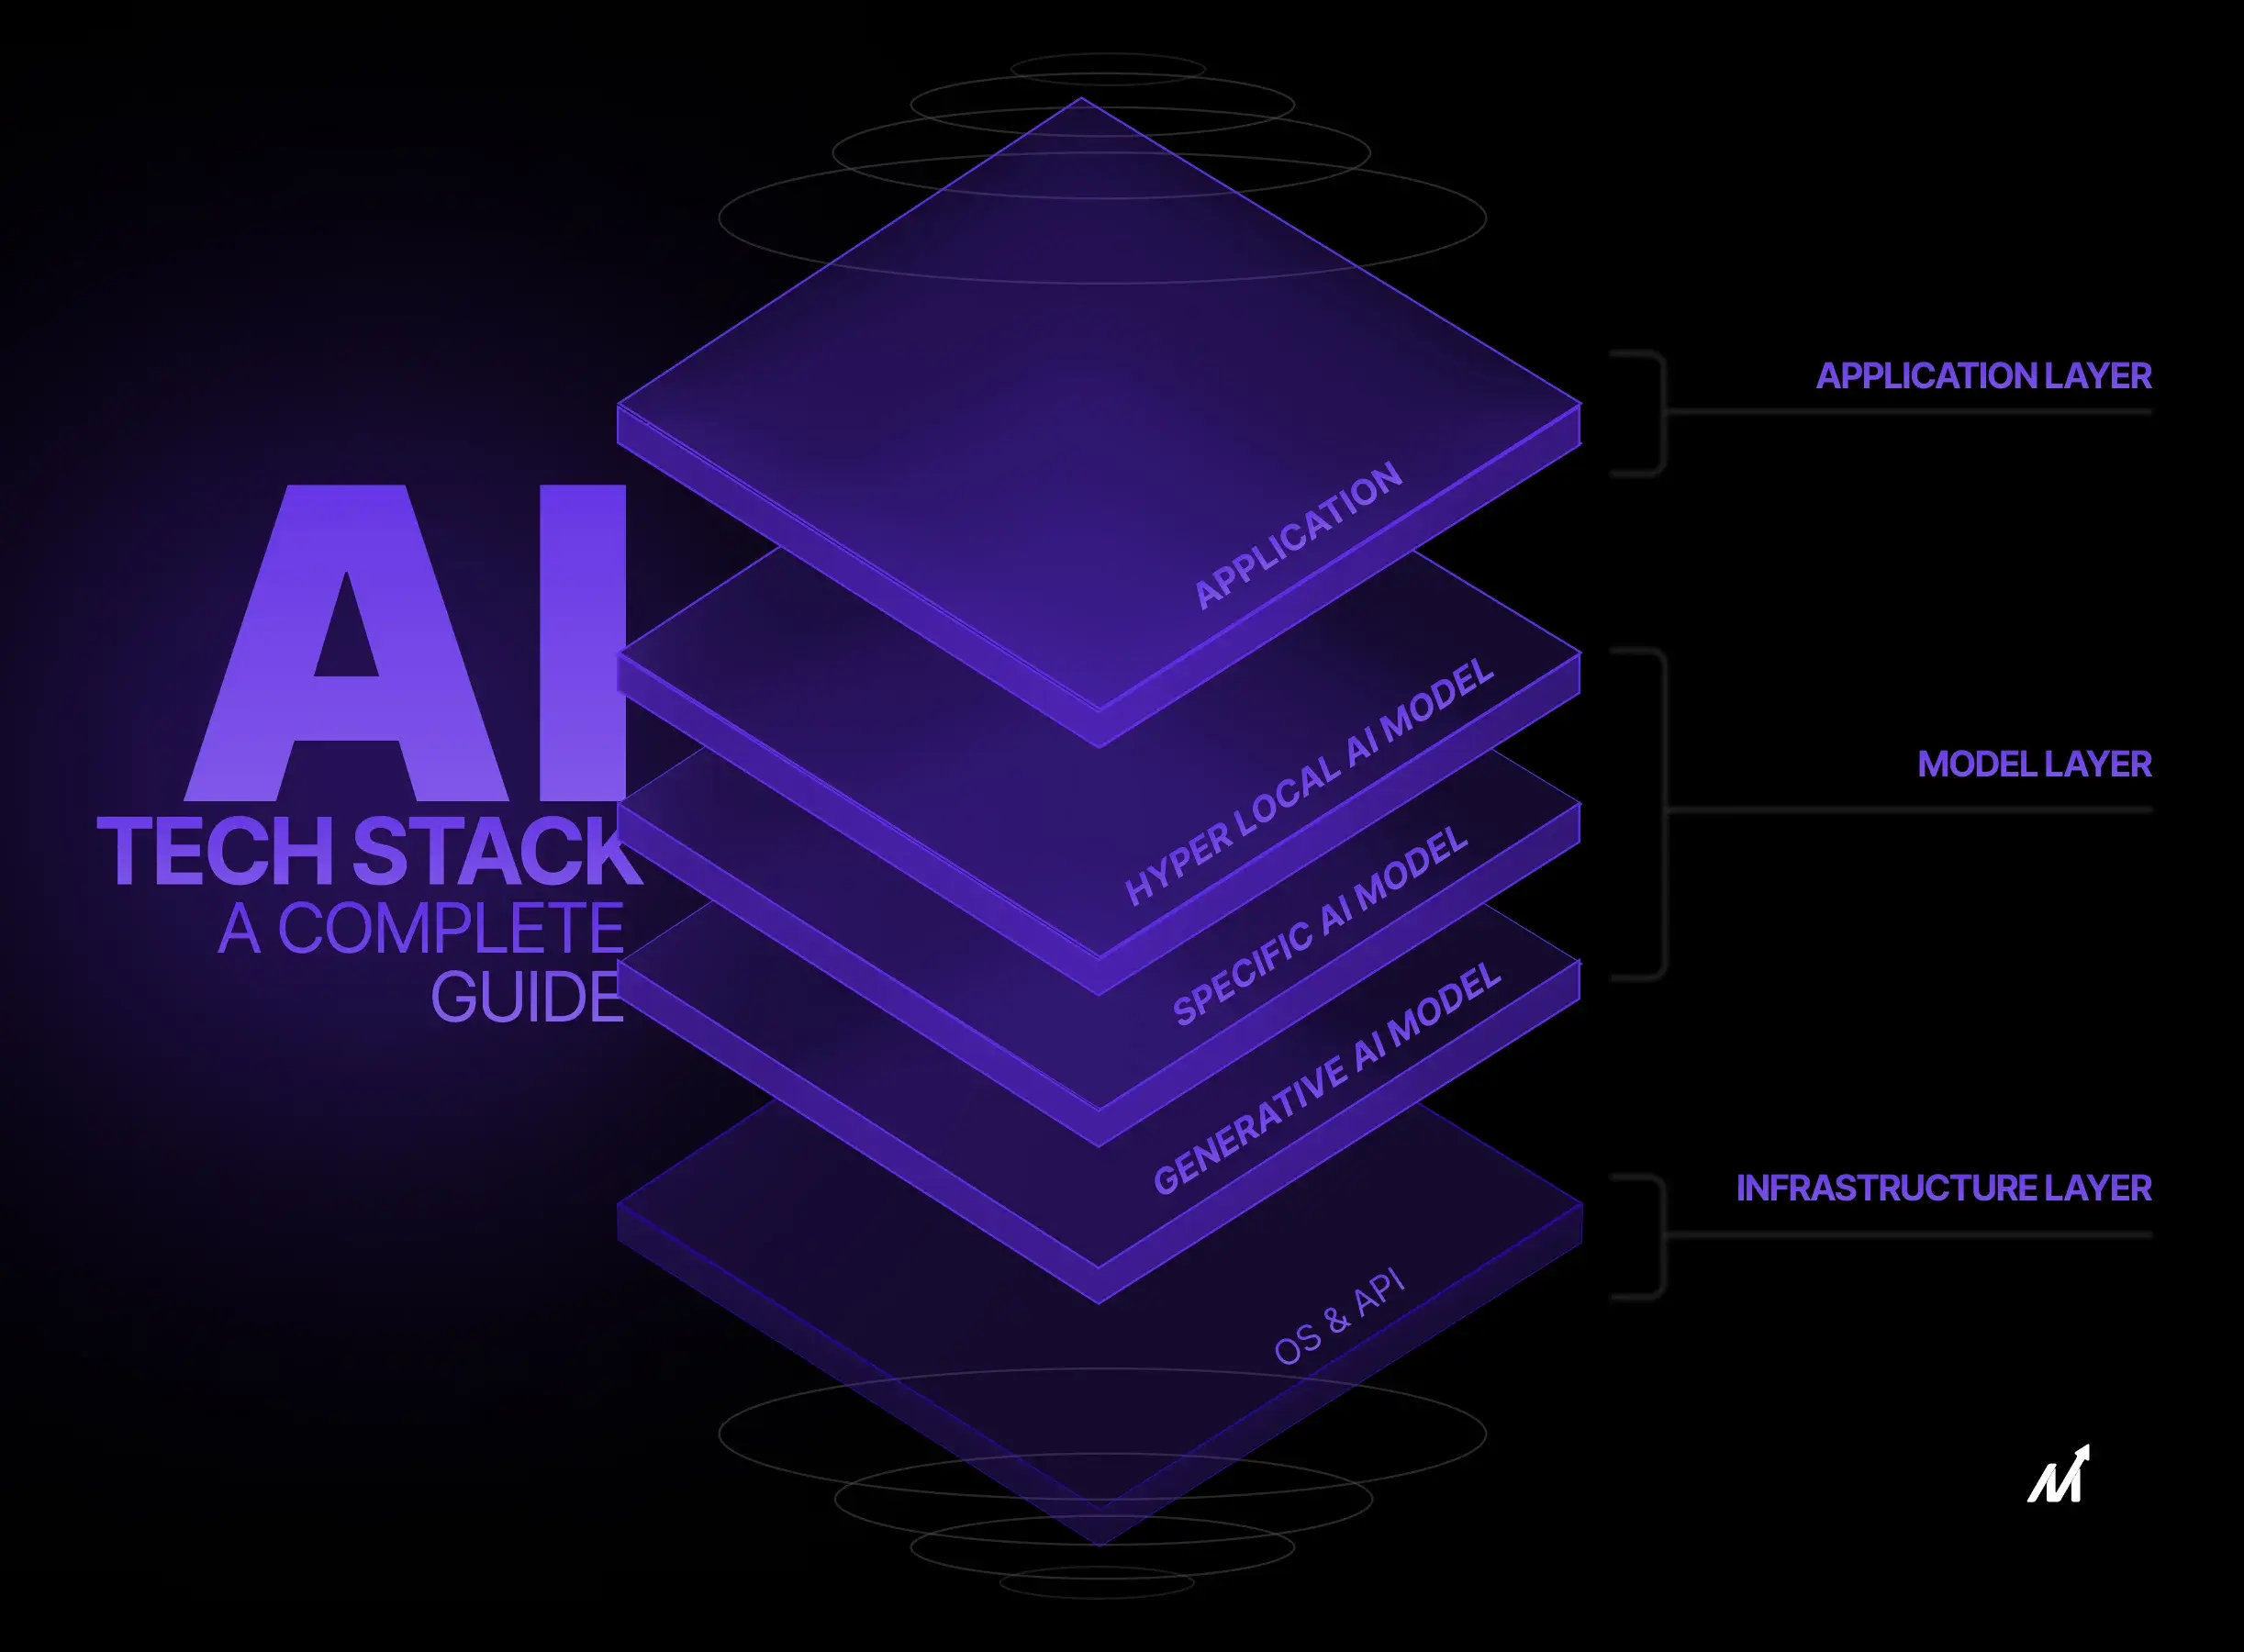
Technologies Used
- Programming: Python (Prototyping), Java/Kotlin (Android).
- Speech Recognition: Vosk or PocketSphinx (online).
- NLP: NLTK / TensorFlow (optional).
- Text-to-Speech (TTS): OpenTTS / eSpeak.
- Android Integration: Android Studio (Java/Kotlin).

Slide 7
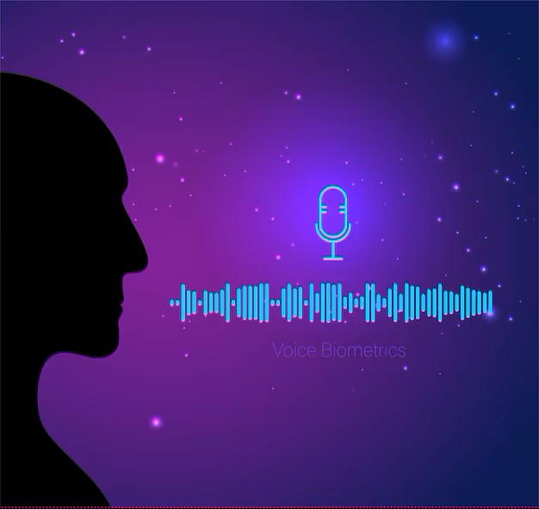
System Architecture
- Voice Activation: Detects 'Lizza' keyword.
- Speech Processing: Converts speech to text.
- Command Interpretation: Recognizes and processes commands.
- Action Execution: Performs requested tasks.
- Feedback System: Provides voice responses.

Slide 8

Implementation & Working
- Step 1: User says 'Lizza' to wake the assistant.
- Step 2: The assistant listens to the command.
- Step 3: The command is processed and mapped to an action.
- Step 4: The task is executed.
- Step 5: User gets an audio confirmation.

Slide 9
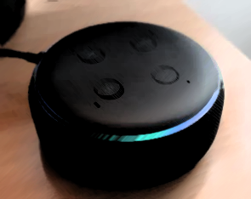
Challenges & Solutions
- Challenge: Achieving high accuracy in speech recognition online.
• Solution: Using Vosk or PocketSphinx trained models.
- Challenge: Efficient task execution with minimal latency.
• Solution: Optimizing command processing pipeline.
- Challenge: Adapting to different voice tones and accents.
• Solution: Fine-tuning speech models with diverse datasets.

Slide 10
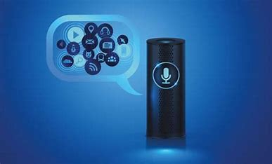
Future Scope
- Adding multi-language support.
- Integrating AI-driven conversation capabilities.
- Expanding IoT control (e.g., smart home devices).
- Enhancing personaLizzation features.

Slide 11

Conclusion
- Lizza is a fast, online, and secure voice assistant.
- It offers multi-functionality with seamless execution.
- A step towards privacy-focused and efficient AI assistants.

Slide 12

Q&A
- Any questions?
- Open for feedback and improvements!

